Slide 1


HR PERFORMANCE REPORT
GRADUATION PROJECT

Slide 2


Mahmoud Mohamed Samir | Data Cleaning, Data Modeling, Data Visualization
Omar Khaled Tharwat | Data Cleaning, Data Modeling, Data Visualization
Logine Mohamed Abd El-Fattah | Data Visualization
Eyad Alaa Abu El-Foutouh | Data Visualization
Abdelrahman Nagy Ahmed | Data Visualization
Mohamed Ali Abd El-Naby | Data Visualization
Members

Slide 3

Table of Contents
1
2
3
4
Project Overview
Modeling
Dataset Description
KPIs and Charts

Slide 4






Project Overview
THIS PROJECT FOCUSES ON ANALYZING HUMAN RESOURCES DATA TO UNCOVER ACTIONABLE INSIGHTS INTO EMPLOYEE DEMOGRAPHICS, PERFORMANCE, SALARY DISPARITIES, AND ATTRITION.
BY LEVERAGING MICROSOFT POWER BI, WE BUILT AN END-TO-END ANALYTICS PIPELINE—FROM DATA INGESTION AND CLEANING USING POWER QUERY TO ROBUST DAX MEASURES AND AN OPTIMIZED STAR SCHEMA MODEL. THE RESULTING INTERACTIVE DASHBOARDS EMPOWER BUSINESS LEADERS TO MAKE DATA-DRIVEN DECISIONS THAT ENHANCE EMPLOYEE RETENTION AND OPERATIONAL EFFICIENCY.

Slide 5
Dataset Description
EmployeeID - Unique identifier for an individual employee FirstName & LastName - Employee's name Gender & Age - Demographic information Department & JobRole - Organizational placement DistanceFromHome (KM) - Distance to workplace Education & EducationField - Educational background MaritalStatus - Marital status of the employee Salary - Employee compensation OverTime - Whether the employee works overtime HireDate - Date the employee joined the company Attrition - Whether the employee has left the company YearsAtCompany - Total tenure at the company YearsSinceLastPromotion - Time since last promotion PerformanceID - Unique identifier for a performance review JobSatisfaction & EnvironmentSatisfaction - Employee satisfaction ratings WorkLifeBalance - Rating of the employee's work-life balance SelfRating & ManagerRating - Performance evaluation scores

Slide 6

Problems of Data
Empty Cells
Data Type Inconsistencies
Flat File (Needs Star Schema)
Outliers in Salary

Slide 7
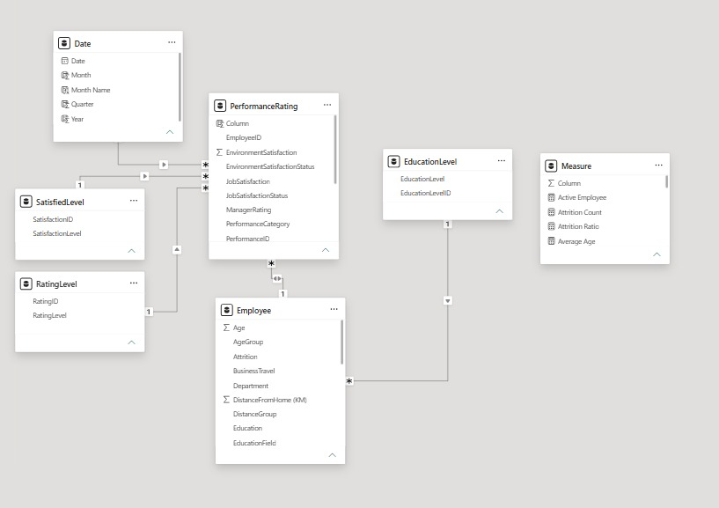
Semantic Model
An optimized relational data model utilizing a star schema for fast aggregations and clean relationships in Power BI

Slide 8
Performance Rating Fact
Columns
EmployeeID
EnvironmentSatisfaction
EnvironmentSatisfactionStatus
JobSatisfaction
JobSatisfactionStatus
ManagerRating
PerformanceCategory
PerformanceID

Slide 9
Dimension Tables
Date Dim Columns
Date (Primary Key)
Month
Month Name
Quarter
Year
EducationLevel Dim Columns
EducationLevelID (Primary Key)
EducationLevel
SatisfiedLevel Dim Columns
SatisfactionID (Primary Key)
SatisfactionLevel
RatingLevel Dim Columns
RatingID (Primary Key)
RatingLevel

Slide 10

KPIS and Charts

Slide 11
KPIs Categories
Attrition & Demographics
Compensation & Performance
Total & Active Employees
Attrition Count & Rate
Gender Diversity Ratio
Average Age
Average Tenure
Total Payroll
Average & Median Salary
Salary Range (Min/Max)
Promotion Recency
Overtime Rate

Slide 12
Charts Categories
Attrition & Demographics
Attrition by Department & Job Role
Attrition by Overtime Status
Active vs. Attrited Employees
Workforce Age Distribution
Gender Distribution (Male vs. Female %)

Slide 13
Charts Categories
Compensation & Performance
Average Salary by Job Role
Salary Outlier Bounds (IQR Method)
Performance Rating by Department
Job & Environment Satisfaction Levels
Salary vs. Years at Company

Slide 14
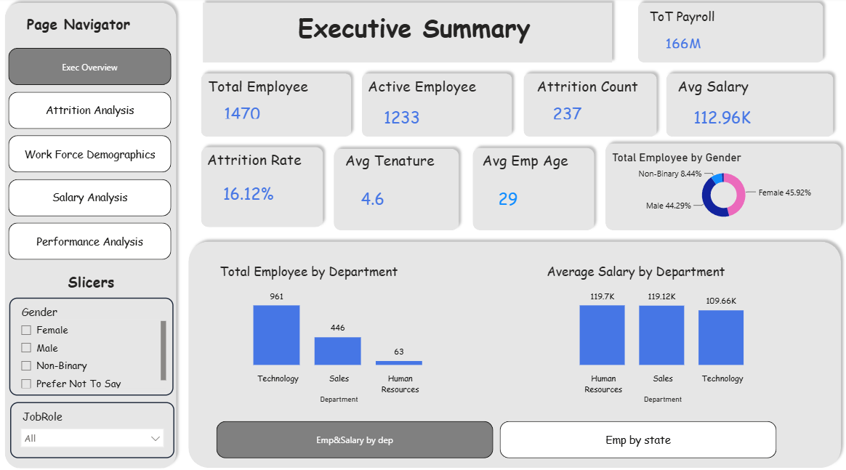
Executive Summary

Slide 15
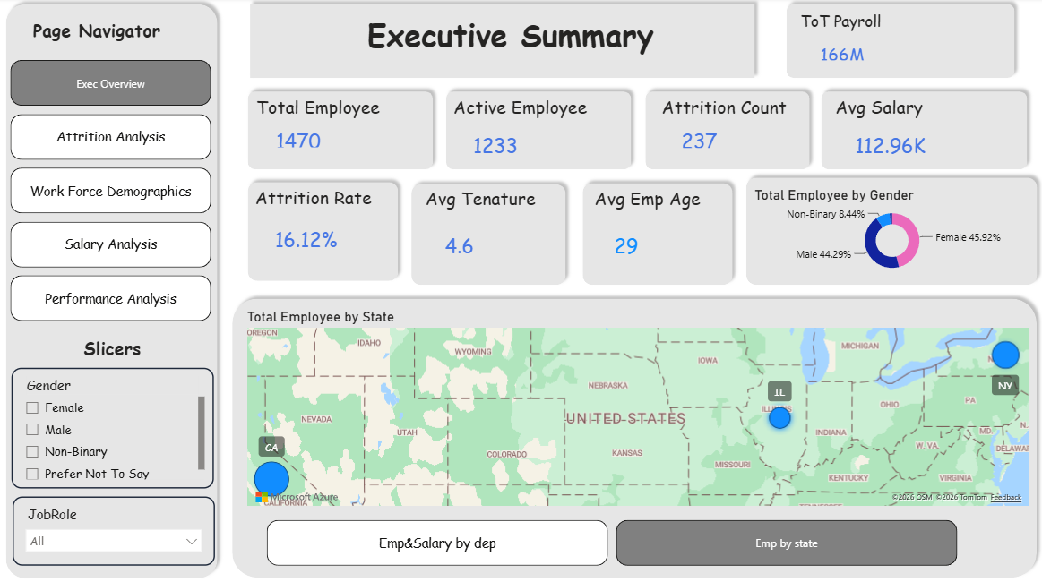
Executive Summary

Slide 16
Data insights
1-Executive Summary & Geographic Distribution
Workforce Breakdown: The company manages a total of 1,470 employees, with 1,233 active staff and an overall attrition count of 237. This yields a high overall Attrition Rate of 16.12%.
Demographic Profile: The workforce leans incredibly young, with an Average Employee Age of 29 and a stable Average Tenure of 4.6 years.
Gender Balance: The organization has a healthy gender split—45.92% Female, 44.29% Male, and 8.44% Non-Binary.
Geographic Footprint: The "Total Employee by State" map shows concentration primarily in three major hubs: California (CA), Illinois (IL), and New York (NY).

Slide 17
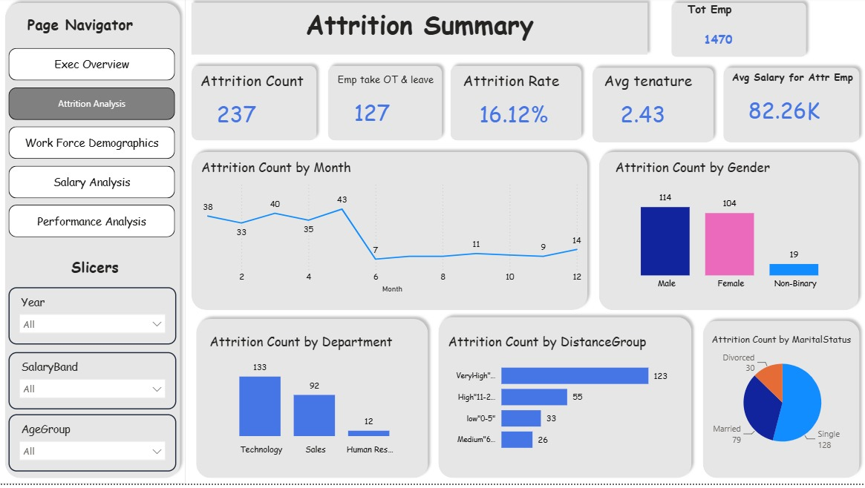
Attrition Summary

Slide 18
Data insights
2-Attrition Risk & Behavior Analysis
The Overtime Connection: Out of the 237 employees who left, 127 took overtime and then resigned. This indicates that nearly 54% of your attrition is heavily correlated with workload fatigue and burnout.
Financial Profile of Leavers: The Average Salary for Attriting Employees is $82.26K, which sits significantly below the company-wide average salary of $112.96K. This implies undercompensation could be a heavy secondary driver for departures.
Departures by Tenure: Employees who leave exit very early in their lifecycle, showing an Average Tenure of just 2.43 years (compared to the company average of 4.6).

Slide 19
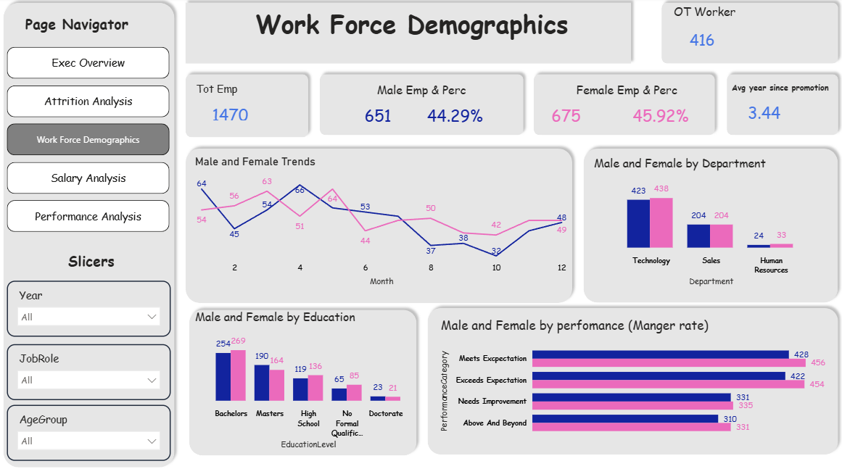
Workforce Demographics

Slide 20
Data insights
3. Workforce Demographics & Operational Balance
Overtime Reliance: There are 416 Overtime Workers in the organization. Given that 127 people worked overtime and left, managing the workload of this specific pool is highly critical.
Departmental Staffing: The workforce is heavily concentrated in Technology (423 Male / 438 Female) and Sales (204 Male / 204 Female), maintaining almost perfect gender parity across these primary business units. Human Resources is tiny by comparison (24 Male / 33 Female).
Education vs. Performance: The majority of the workforce holds a Bachelors (254M / 269F) or Masters (190M / 164F) degree. Interestingly, when looking at performance by manager ratings, the counts of employees meeting or exceeding expectations remain highly balanced across both genders (e.g., Exceeds Expectations: 422 Male vs. 454 Female).

Slide 21
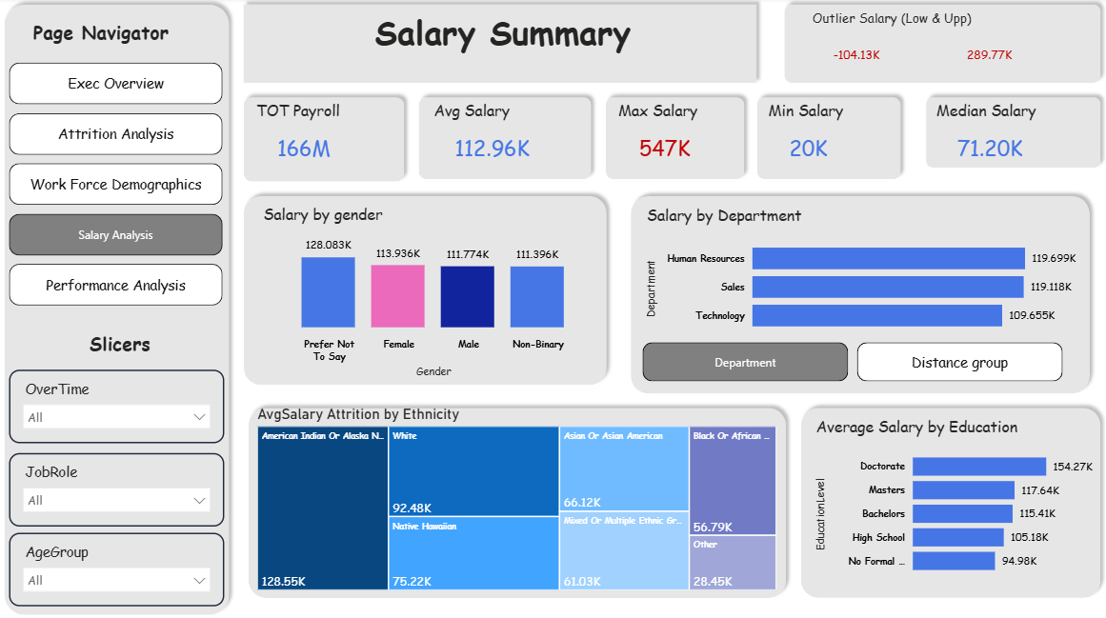
Salary Summary

Slide 22
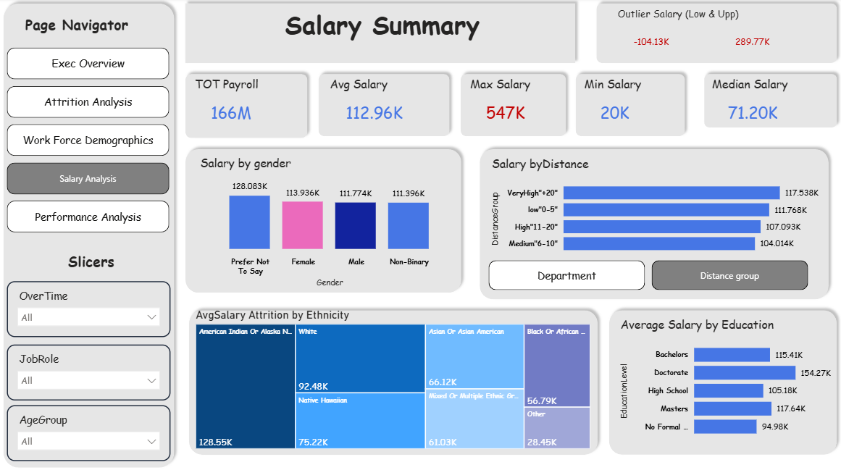
Salary Summary

Slide 23
Data insights
4. Compensation & Pay Equity Analysis
Payroll & Salary Disparities: The total company payroll sits at $166M with an Average Salary of $112.96K. However, the Median Salary is $71.20K, meaning a small portion of extremely high earners is inflating the average. This is supported by a Maximum Salary of $547K against a Minimum Salary of $20K, alongside an upper outlier threshold of $289.77K.
Departmental Pay: Human Resources actually holds the highest average salary at $119.69K, closely followed by Sales ($119.11K), while Technology lags behind at $109.65K (which may further explain the high attrition seen in Tech).
Education Premium: Compensation tracks linearly with education level. Doctorate holders average $154.27K, while those with No Formal Qualification average $94.98K.

Slide 24
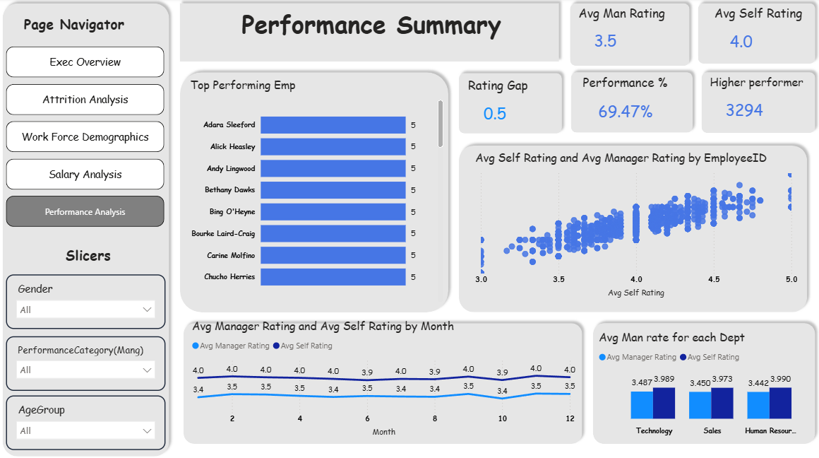
Performance Summary

Slide 25
Data insights
5. Performance & Perception Gaps
The Self-Appraisal Gap: There is a clear Rating Gap of 0.5. On average, employees rate themselves higher (Average Self Rating: 4.0) than their managers rate them (Average Manager Rating: 3.5).
Departmental Trends: This perception gap is completely uniform across all business branches. In every single department, the average self-rating hovers around 3.9, while managers consistently rate them around 3.4.
Consistent Disconnect: The "Avg Manager Rating and Avg Self Rating by Month" line chart shows that this half-point disconnect remains completely flat and unbroken throughout all 12 months of the fiscal cycle.

Slide 26
Thank you

